Slide 1

Cybersecurity Analyst Preparation – AI/ML, SIEM, SOAR, EDR, and Vulnerability Management
Essential skills for modern cybersecurity professionals
Notes:
AI-generated content may be incorrect. ---

Slide 2
Job Overview
Notes:
Cybersecurity Analyst – Role & Responsibilities, What is IAT Level II?, Interview Panel Expectations

Slide 3

Cybersecurity Analyst – Role & Responsibilities
Threat Monitoring and Detection
Analysts monitor security alerts and use AI/ML, EDR, and SIEM tools to detect potential cyber threats in real time.
Incident Investigation and Response
They investigate security incidents, respond promptly, and escalate critical issues to protect organizational assets.
Automation and Rule Development
Analysts develop detection rules and automated playbooks to enhance security efficiency and reduce manual tasks.
Collaboration and Compliance
Effective teamwork with IT, DevOps, and business units ensures alignment with security policies and compliance standards.
Notes:
A Cybersecurity Analyst is responsible for monitoring, detecting, and responding to security threats using advanced tools such as AI/ML, Endpoint Detection and Response (EDR) solutions like CrowdStrike, SIEM platforms like Splunk, SOAR automation systems, and vulnerability management tools such as Qualys. Their duties include analyzing alerts, investigating incidents, and escalating issues when necessary. Analysts also develop and tune detection rules and automated playbooks to improve efficiency. Collaboration with IT, DevOps, and business teams is essential to ensure security measures align with organizational goals. Compliance with standards like IAT Level II is often required, emphasizing the need for strong technical skills combined with effective communication and problem-solving abilities.

Slide 4

What is IAT Level II?
Certification Overview
IAT Level II certifies foundational cybersecurity knowledge under DoD 8570/8140 guidelines.
Core Knowledge Areas
Focus areas include security concepts, network defense, and incident response skills.
Relevant Certifications
Key certifications include CompTIA Security+, CCNA Security, CySA+, GICSP, and SSCP.
Importance and Application
These certifications validate ability to secure systems and address threats in government roles.
Notes:
IAT Level II refers to the Information Assurance Technical Level II certification requirement under DoD 8570/8140 guidelines. It ensures that cybersecurity professionals possess foundational knowledge in security concepts, network defense, and incident response. Certifications that meet this requirement include CompTIA Security+, CCNA Security, CySA+, GICSP, and SSCP. These credentials validate an individual's ability to maintain secure systems and respond effectively to threats, making them essential for roles in government and defense sectors.

Slide 5

Interview Panel Expectations
Technical Proficiency
Candidates must demonstrate skills in EDR, SIEM, SOAR, and vulnerability management tools for cybersecurity roles.
AI and Machine Learning Knowledge
Understanding AI/ML applications in cybersecurity is increasingly critical for modern security challenges.
Analytical and Communication Skills
Interviewers value problem-solving, analytical thinking, and the ability to explain complex topics clearly.
Learning Attitude and Adaptability
Eagerness to learn, adaptability, and hands-on lab practice can offset limited professional experience.
Notes:
Interview panels typically expect candidates to demonstrate technical proficiency with EDR, SIEM, SOAR, and vulnerability management tools. A solid understanding of AI/ML applications in cybersecurity is increasingly important. Panels look for problem-solving skills, analytical thinking, and the ability to explain complex topics in simple terms. They value eagerness to learn, adaptability, and resourcefulness. While extensive experience is ideal, strong hands-on lab practice and a proactive learning attitude can compensate for limited professional exposure.

Slide 6
CrowdStrike (EDR) Fundamentals
Notes:
What is an EDR Agent?, Falcon Console – Detections, Incidents, Threat Intel, Agent-Based vs. Agentless, Real-World EDR Examples, Common EDR Interview Questions

Slide 7

What is an EDR Agent?
Lightweight Endpoint Software
EDR agents are lightweight software installed to monitor endpoint processes and user activities continuously.
Telemetry Data Collection
They collect and transmit telemetry data to a cloud console for centralized analysis and threat detection.
Real-time Threat Response
EDR enables real-time detection and response to security threats by acting as primary sensors on devices.
Notes:
An Endpoint Detection and Response (EDR) agent is a lightweight software installed on endpoints to monitor processes, file changes, network connections, and user behavior. It collects telemetry data and sends it to a cloud-based console for analysis. This enables real-time detection and response to threats. EDR agents act as the primary sensors on devices, providing visibility into activities that could indicate malicious behavior.

Slide 8

Falcon Console – Detections, Incidents, Threat Intel
Detections as Alerts
Detections are alerts triggered by suspicious activities that flag potential security issues.
Incident Grouping
Incidents group related detections into single events to streamline investigation and response.
Threat Intelligence Context
Threat intelligence provides attacker information and tactics, enhancing understanding of security threats.
Effective Threat Response
This structured approach helps analysts prioritize alerts and respond efficiently to security threats.
Notes:
CrowdStrike's Falcon console organizes security data into detections, incidents, and threat intelligence. Detections are alerts triggered by suspicious activity, while incidents group related detections into a single event for easier investigation. Threat intelligence adds context by providing information about attackers, tactics, techniques, and procedures (TTPs). This structured approach helps analysts prioritize and respond effectively to threats.

Slide 9

Agent-Based vs. Agentless
Agent-Based Solutions
Require software installation on endpoints, enabling deep visibility and real-time threat response.
Agentless Solutions
Utilize network scanning, APIs, or cloud integrations, simplifying deployment but with less detailed data.
Security Strategy Trade-Offs
Choosing between agent-based and agentless requires weighing visibility versus ease of deployment.
Notes:
Agent-based solutions, like CrowdStrike Falcon, require software installation on endpoints, offering deep visibility and real-time response capabilities. Agentless solutions rely on network scanning, APIs, or cloud-native integrations, which can be easier to deploy but may provide less granular data. Understanding the trade-offs between these approaches is crucial for designing effective security strategies.

Slide 10

Real-World EDR Examples
Ransomware Detection and Isolation
EDR systems detect encryption behaviors to block ransomware and isolate affected endpoints to prevent spread.
Command-and-Control Detection
EDR identifies command-and-control connections by flagging unusual outbound network traffic effectively.
Fileless Attack Detection
EDR monitors suspicious PowerShell scripts and memory-only malware to detect fileless cyber attacks.
Notes:
EDR solutions have proven effective in blocking ransomware by detecting encryption behaviors and isolating affected endpoints. They can identify command-and-control connections by flagging unusual outbound traffic and detect fileless attacks through monitoring of suspicious PowerShell scripts or memory-only malware. These capabilities highlight the importance of EDR in modern cybersecurity defense.

Slide 11

Common EDR Interview Questions
EDR vs Traditional Antivirus
Understand how EDR provides active threat detection and response beyond basic antivirus capabilities.
Alert Response Steps
Know the essential steps to take immediately when an EDR alert is triggered to mitigate risks.
Detection vs Prevention
Explain the key differences between detecting threats and preventing them in cybersecurity frameworks.
Investigating Suspicious Processes
Describe methods to analyze and investigate suspicious processes using EDR tools and techniques.
Notes:
Typical interview questions include: How does EDR differ from traditional antivirus? What steps do you take when an alert fires? Explain the difference between detection and prevention. How do you investigate a suspicious process? Preparing answers with real-world examples or lab scenarios can demonstrate practical knowledge and problem-solving skills.

Slide 12
Qualys Vulnerability Management
Notes:
What is a Vulnerability Scanner?, Agent vs. Scan-Based Discovery, Interpreting CVSS, Severity, QIDs, Noise in Vulnerability Data, Dashboards, Baselines, Reports, Vulnerability Management Workflow

Slide 13
What is a Vulnerability Scanner?
Purpose of Vulnerability Scanner
A vulnerability scanner detects system weaknesses like missing patches and misconfigurations to enhance security.
Cloud-based Solution Features
Cloud-based solutions support agent-based and scan-based discovery methods for comprehensive vulnerability detection.
Risk Management Benefits
Proactive detection of vulnerabilities helps organizations manage risk and prevent cyberattacks effectively.
Notes:
A vulnerability scanner identifies weaknesses in systems, such as missing patches or misconfigurations. Qualys is a cloud-based solution that supports both agent-based and scan-based discovery methods. It helps organizations proactively manage risk by detecting vulnerabilities before attackers exploit them.

Slide 14

Agent vs. Scan-Based Discovery
Agent-Based Discovery
Agent-based discovery installs software on devices for continuous monitoring, including offline endpoints.
Scan-Based Discovery
Scan-based discovery uses network scanners to periodically assess network assets, possibly missing offline devices.
Choosing the Right Approach
Selecting between agent and scan-based depends on organizational needs and infrastructure complexity.
Notes:
Agent-based discovery involves installing software on endpoints for continuous monitoring, even when devices are off-network. Scan-based discovery uses network scanners for periodic assessments but may miss offline assets. Choosing the right approach depends on organizational needs and infrastructure complexity.

Slide 15

Interpreting CVSS, Severity, QIDs
CVSS Scoring System
CVSS scores vulnerabilities from 0 to 10 to provide a standard measure of risk severity.
Severity Levels
Severity ranges from Critical to Low, helping prioritize vulnerability remediation efforts.
Qualys Identification
Qualys assigns QIDs to vulnerabilities for easy identification and tracking.
Risk Prioritization
Focus on high CVSS scores and critical severity vulnerabilities to effectively reduce risk.
Notes:
CVSS (Common Vulnerability Scoring System) rates vulnerabilities on a scale from 0 to 10. Severity levels range from Critical to Low, guiding prioritization efforts. Qualys assigns QIDs (Qualys IDs) to each vulnerability for easy tracking. Analysts should focus on high CVSS scores and critical severity issues to reduce risk effectively.

Slide 16

Noise in Vulnerability Data
Definition of Noise
Noise includes false positives, low-risk findings, and duplicate entries that clutter vulnerability data and confuse teams.
Impact on Vulnerability Management
Excess noise overwhelms security teams and hides real threats, reducing the effectiveness of vulnerability remediation.
Noise Filtering Importance
Effective filtering focuses efforts on exploitable, high-impact vulnerabilities, improving remediation outcomes and security posture.
Notes:
Noise refers to false positives, low-risk findings, and duplicate entries that can overwhelm teams and obscure real threats. Effective vulnerability management requires filtering out noise and focusing on exploitable, high-impact vulnerabilities to optimize remediation efforts.

Slide 17

Dashboards, Baselines, Reports
Dashboards for Risk Insights
Dashboards visualize current risk posture and trends, offering clear insights for quick understanding.
Baselines Define Normal States
Baselines establish normal conditions for effective comparison and anomaly detection.
Weekly Reports Track Progress
Weekly reports monitor remediation efforts and communicate risk status to leadership.
Notes:
Dashboards provide visual insights into risk posture and trends, while baselines define normal states for comparison. Weekly reports track remediation progress and help communicate risk to leadership. These tools enable informed decision-making and continuous improvement in vulnerability management.

Slide 18

Vulnerability Management Workflow
System Scanning
Scanning systems identifies potential security vulnerabilities that need assessment and remediation.
Risk Prioritization
Vulnerabilities are prioritized based on their risk level to focus on the most critical issues first.
Remediation Assignment
Assigning remediation tasks ensures accountability and timely resolution of vulnerabilities.
Verification of Fixes
Verifying fixes confirms that vulnerabilities have been effectively resolved to maintain security.
Notes:
The typical workflow includes scanning systems, prioritizing vulnerabilities based on risk, assigning remediation tasks, implementing fixes, and verifying resolution. This structured approach ensures vulnerabilities are addressed systematically and efficiently.

Slide 19
Splunk + SOAR
Notes:
Log Ingestion in Splunk, SPL Searches Made Simple, SOAR Overview & Playbooks

Slide 20
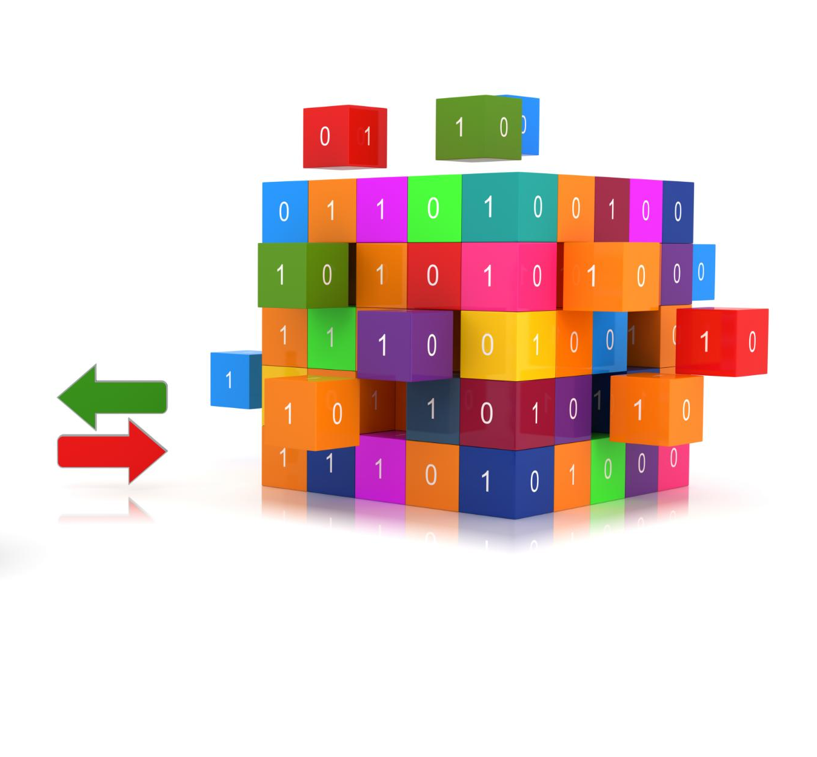
Log Ingestion in Splunk
Indexing of Logs
Logs are ingested and stored in indexes to enable organized and efficient data retrieval in Splunk.
Categorization by Sourcetypes
Logs are categorized using sourcetypes which define the format and structure of the log data for easier searching.
Querying via Search Heads
Search heads enable querying and analysis of the indexed and categorized log data for insightful results.
Notes:
Splunk ingests logs through a process involving indexing, sourcetypes, and search heads. Data is stored in indexes, categorized by sourcetypes, and queried via search heads. This structure enables efficient storage, retrieval, and analysis of large volumes of log data.

Slide 21

SPL Searches Made Simple
Pattern and Anomaly Detection
SPL enables searching logs to identify patterns and anomalies like multiple failed login attempts signaling attacks.
Filtering and Statistical Analysis
SPL supports filtering log data and performing statistical analysis to extract meaningful insights.
Visualization for Threat Detection
SPL's visualization features help analysts detect threats effectively through graphical data representation.
Notes:
Splunk's Search Processing Language (SPL) allows analysts to query logs for patterns and anomalies. For example, searching for multiple failed login attempts can reveal brute force attacks. SPL supports filtering, statistical analysis, and visualization, making it a powerful tool for threat detection.

Slide 22
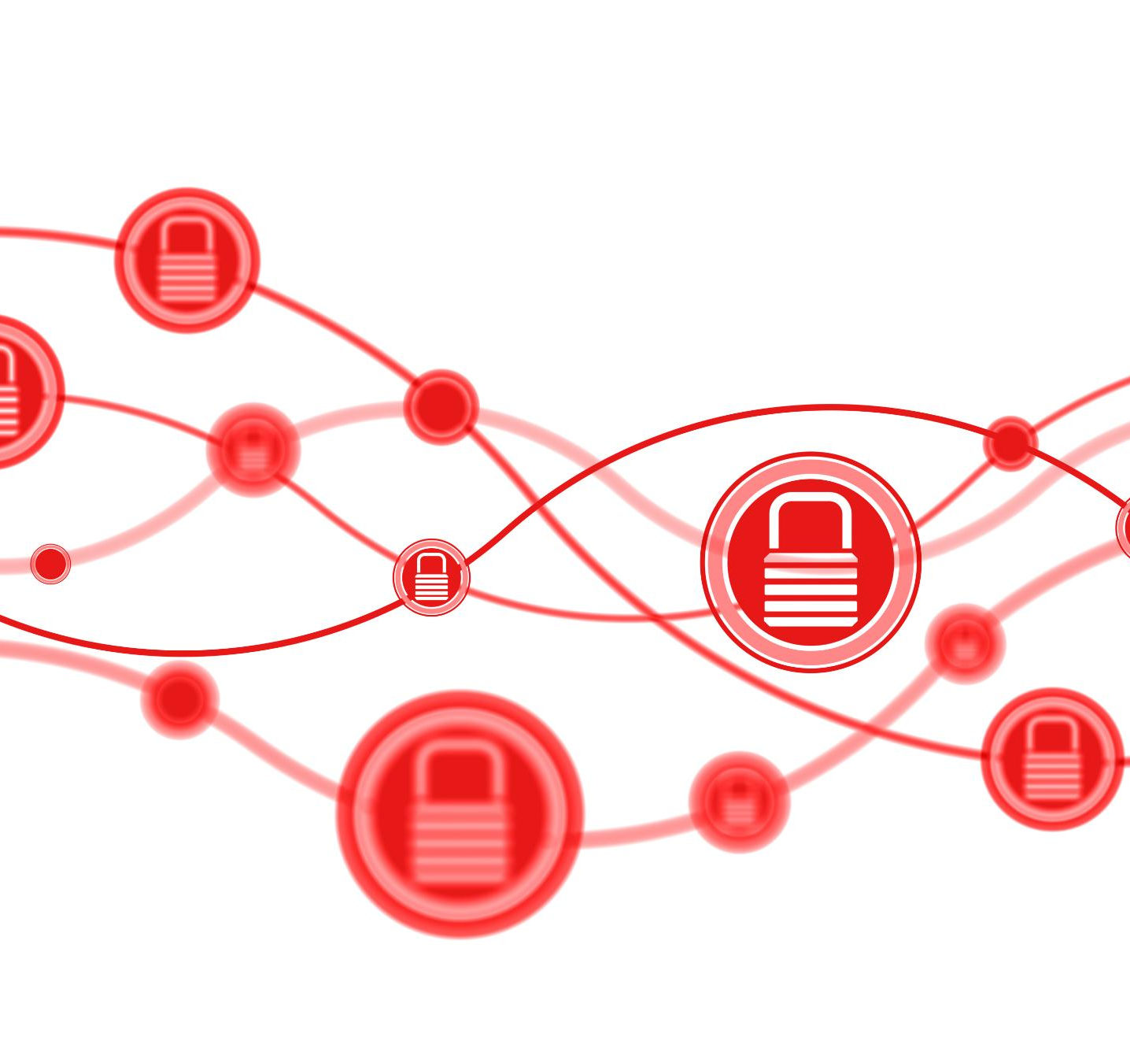
SOAR Overview & Playbooks
SOAR Platform Functionality
SOAR platforms automate security tasks to streamline incident response and improve operational efficiency.
Playbooks in SOAR
Playbooks are predefined workflows that orchestrate alert enrichment, blocking threats, and ticket creation.
Benefits of Automation
Automation reduces response times and allows analysts to focus on complex threat investigations.
Notes:
SOAR (Security Orchestration, Automation, and Response) platforms automate repetitive tasks through playbooks—predefined workflows that enrich alerts, block malicious IPs, and create tickets. These automations reduce response time and free analysts for higher-level investigations.

Slide 23
AI/ML in Cybersecurity
Notes:
Adversarial Attacks Explained, AI/ML in Action

Slide 24

Adversarial Attacks Explained
Evasion Attacks
Evasion attacks alter inputs to deceive AI models and avoid detection during operation.
Poisoning Attacks
Poisoning attacks corrupt training data to degrade AI model performance and accuracy.
Prompt Manipulation
Prompt manipulation tricks AI into generating incorrect or harmful outputs through crafted inputs.
Notes:
Adversarial attacks exploit weaknesses in AI models. Evasion attacks modify inputs to avoid detection, poisoning attacks corrupt training data, and prompt manipulation tricks AI systems into producing incorrect outputs. Understanding these threats is essential for securing AI-driven defenses.

Slide 25

AI/ML in Action
Anomaly Detection
AI uses anomaly detection to identify unusual patterns indicating potential cyber threats effectively.
Machine Learning in Antivirus
Machine learning models analyze data patterns to detect unknown threats in antivirus and EDR solutions.
Augmenting Human Analysts
AI technologies support human analysts by enabling faster and more accurate threat detection and risk scoring.
Notes:
AI enhances cybersecurity through anomaly detection, clustering, and risk scoring. Machine learning models in antivirus and EDR solutions identify unknown threats by analyzing patterns. These technologies augment human analysts, enabling faster and more accurate threat detection.

Slide 26
Cloud Security Basics
Notes:
Top Cloud Threats, Key Cloud Security Terms

Slide 27

Top Cloud Threats
Misconfigured Storage Services
Misconfigured storage services expose sensitive data, making it accessible to unauthorized users and increasing breach risks.
Over-Permissive IAM Roles
Excessive permissions in IAM roles can allow attackers to gain unauthorized access and escalate privileges.
Unpatched Workloads
Unpatched workloads pose vulnerabilities that attackers exploit to compromise cloud environments.
Insecure APIs
Insecure APIs provide entry points for attackers to manipulate cloud services and access data unlawfully.
Notes:
Common cloud threats include misconfigured storage services, over-permissive IAM roles, unpatched workloads, and insecure APIs. These vulnerabilities often result from human error and can lead to significant breaches if not addressed promptly.

Slide 28

Key Cloud Security Terms
Identity and Access Management
IAM manages and controls user access permissions within cloud environments to ensure secure resource usage.
Shared Responsibility Model
This model clarifies security duties shared by cloud providers and customers to protect cloud infrastructure effectively.
Container Security
Container security protects Docker and Kubernetes environments from vulnerabilities and configuration errors.
Notes:
IAM (Identity and Access Management) controls user permissions. The Shared Responsibility Model defines security responsibilities between cloud providers and customers. Container security focuses on protecting Docker and Kubernetes environments from vulnerabilities and misconfigurations.

Slide 29
Hands-On Lab Setup
Notes:
Lab Environment Overview, Sysmon to Splunk Workflow

Slide 30
Lab Environment Overview
Lab Setup Components
The lab setup includes Linux and Windows Server virtual machines equipped with Sysmon for detailed activity logging.
Purpose of Lab Environment
The environment enables analysts to simulate real-world cyber scenarios and collect security logs for analysis.
Log Analysis Tools
Detection techniques are practiced using log analysis tools such as Splunk to identify threats effectively.
Notes:
A practical lab setup includes Linux and Windows Server VMs with Sysmon installed for detailed logging. This environment allows analysts to simulate real-world scenarios, collect logs, and practice detection techniques using tools like Splunk.

Slide 31

Sysmon to Splunk Workflow
Sysmon Log Generation
Sysmon creates detailed logs capturing process creation and network connection events for security monitoring.
Log Conversion to JSON
The collected logs are converted into JSON format for structured ingestion and analysis.
Ingestion into Splunk
JSON logs are ingested into Splunk to enable advanced monitoring and detection in lab environments.
Notes:
Sysmon generates detailed logs on process creation and network connections, which can be converted to JSON and ingested into Splunk. This workflow enables comprehensive monitoring and detection capabilities in a controlled lab environment.

Slide 32
What I've Learned So Far
Notes:
Key Takeaways

Slide 33
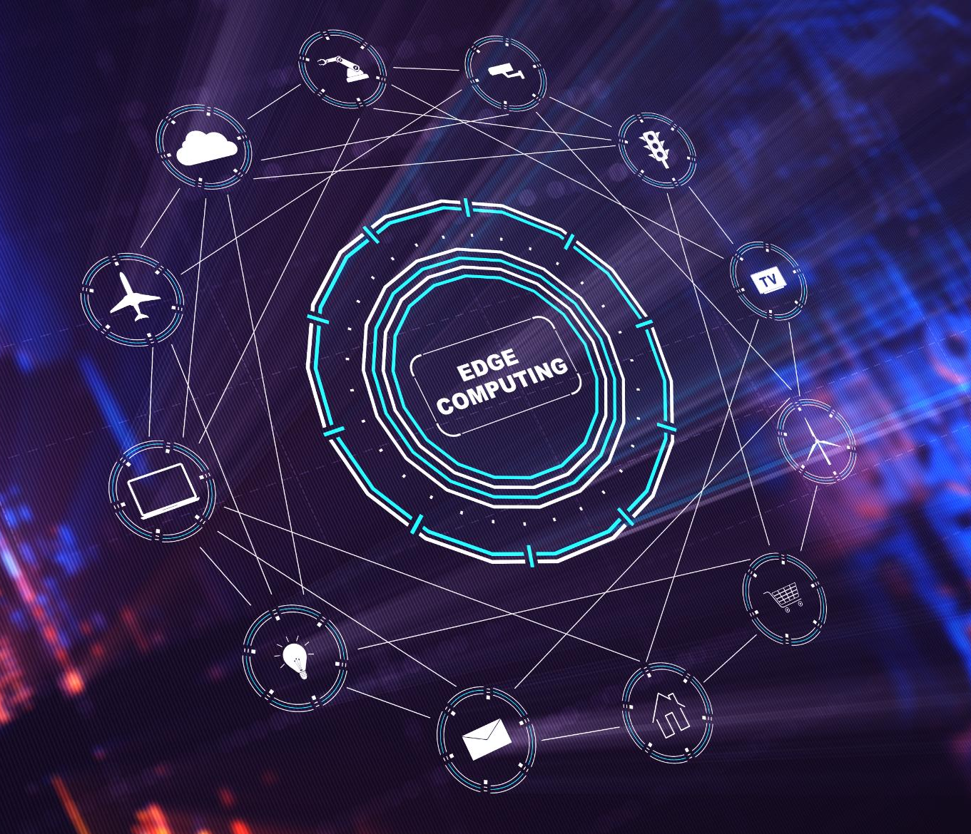
Key Takeaways
Scanning Methods
Understand differences between agent-based and agentless scanning techniques for vulnerability detection.
SOAR and Playbooks
Learn the role of SOAR platforms and playbooks in automating security operations and incident response.
Managing Vulnerability Noise
Techniques to manage noise in vulnerability data improve detection accuracy and focus response efforts.
Cybersecurity Fundamentals
Basics of Sysmon logs, AI attack methods, Python automation, and cybersecurity's value in business.
Notes:
Key lessons include understanding agent vs. agentless scanning, the role of SOAR and playbooks, managing noise in vulnerability data, detection and incident response strategies, Sysmon log collection, AI attack techniques, Python basics for automation, and the value of cybersecurity in business operations.

Slide 34
Final Interview Prep
Notes:
Technical and Behavioral Questions, Tell Me About Yourself & Why You're a Strong Candidate

Slide 35

Technical and Behavioral Questions
Technical Topics Overview
Key technical areas include EDR vs. SIEM, SOAR efficiency, CVSS, and threat detection techniques.
Behavioral Skills Focus
Behavioral questions emphasize problem-solving, continuous learning, and managing stress effectively.
Answer Crafting Strategy
Craft responses showcasing resourcefulness, curiosity, and adaptability to stand out in interviews.
Notes:
Prepare for technical questions on EDR vs. SIEM, SOAR efficiency, CVSS, phishing investigation, playbooks, noise reduction, shared responsibility, machine learning in threat detection, agent vs. agentless scanning, and Splunk queries for brute force detection. Behavioral questions focus on problem-solving, continuous learning, and stress management. Craft answers that highlight resourcefulness, curiosity, and adaptability.

Slide 36

Tell Me About Yourself & Why You're a Strong Candidate
Personal Background & Interest
Share your background and genuine interest in cybersecurity to build rapport and credibility.
Hands-on Experience
Highlight practical lab experience demonstrating your skills and commitment to learning.
Key Soft Skills
Emphasize adaptability, quick learning, and strong communication as your strengths.
Confidence and Passion
Showcase enthusiasm and readiness to contribute despite limited experience with some tools.
Notes:
Introduce your background, interest in cybersecurity, and hands-on lab experience. Emphasize quick learning, adaptability, and strong communication skills. Highlight passion for cybersecurity and readiness to contribute despite limited professional experience with certain tools. Confidence and enthusiasm are key to leaving a positive impression.

